Slide 1
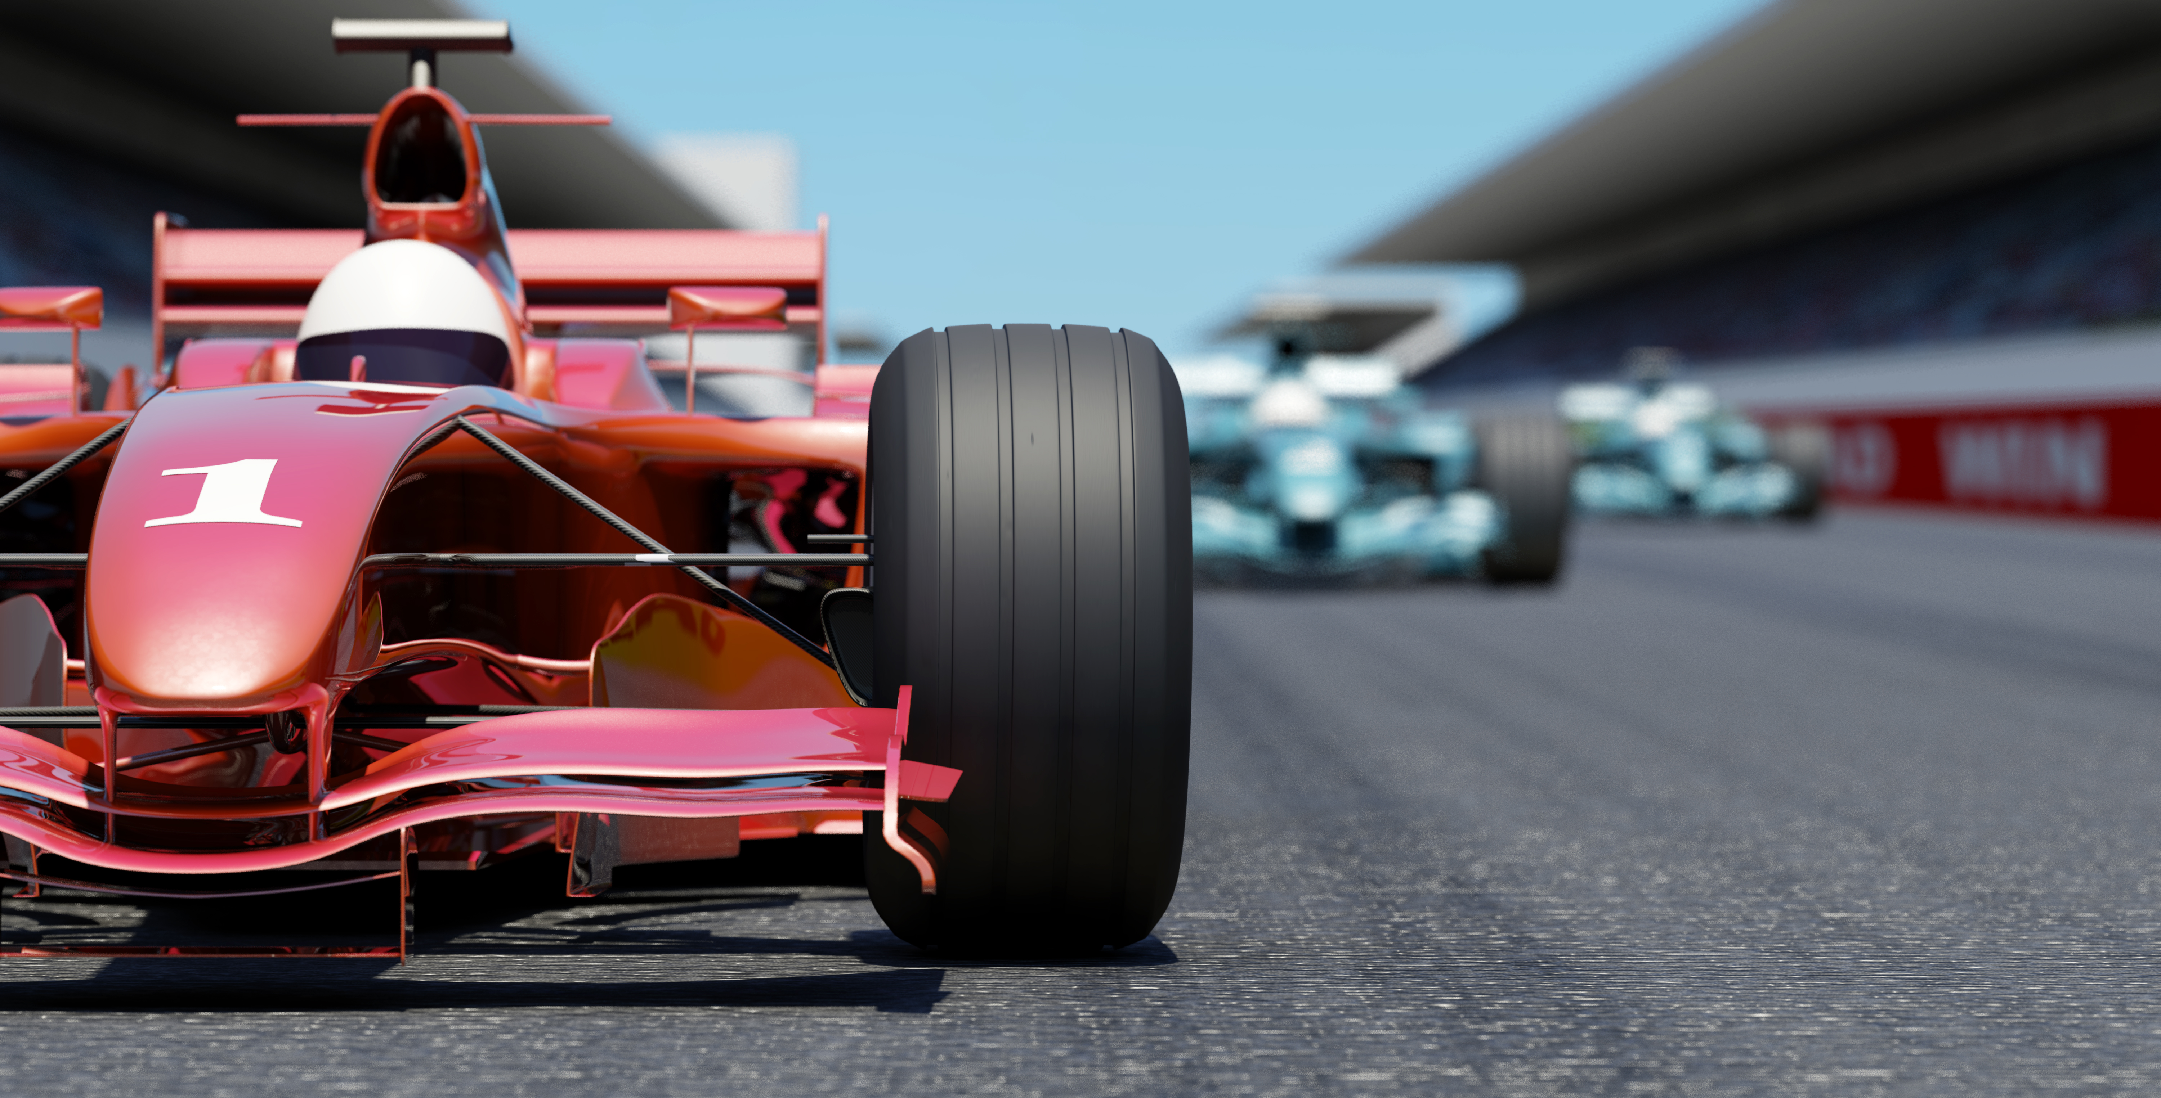
Race Your Rovers Mecanum Edition

Slide 2

Rules
Relay race – each member of a group drives the robot at least once.
Push one “Sample” at a time to the ”Collection Zone”
Fastest Time Wins
Should be much faster than with Differential
drivetrain

